Slide 1
Problem Identification

Slide 2
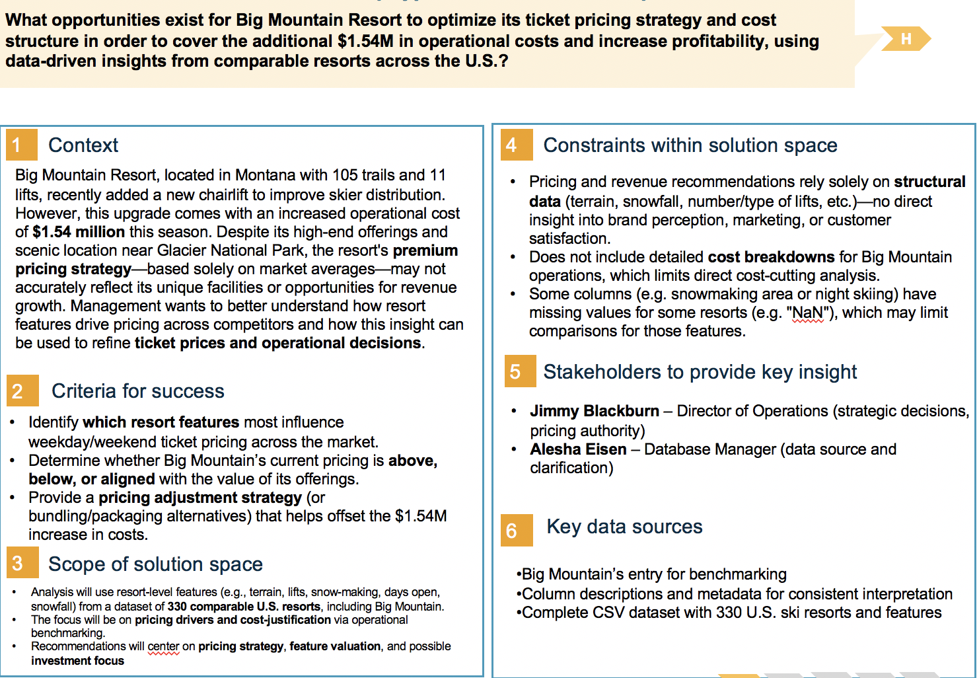

Slide 3
Reccomendations
Key Findings
Current Price vs. Market Potential
◦ Big Mountain currently charges $81 per weekend ticket.
◦ Model suggests facilities could support a slightly higher price, depending on improvements.
Scenario Analysis
1. Close runs: Closing 1 run → no effect. Closing 2–5 runs → small revenue drop. Closing 6+ runs → significant loss in ticket price potential.
2. Add run + lift + +150 ft vertical drop → +$1.99 per ticket (~+$3.47M/season).
3. Add 2 acres snow making (with scenario 2) → No additional effect.
4. Increase longest run by 0.2 mi + snow making → No measurable effect on price.
Do not close more than 1 run; closures beyond that reduce price potential.
Most impactful improvement: Adding a run, lift, and increasing vertical drop.
Snow making and longest run improvements have negligible short-term price benefit.
Before price changes, pilot improvements and gather real customer demand data to validate model assumptions.

Slide 4
Modeling Approach
Random forest model trained on U.S. ski resort dataset to estimate market-supported ticket prices
Excluded Big Mountain data during training to ensure unbiased prediction
Model performance validated through cross-validation and test set consistency
Scenario analysis performed to test sensitivity to facility changes

Slide 5
Baseline Position
Current weekend ticket price: $81
Model-predicted price based on facilities: slightly higher than current price
Indicates potential underpricing in current market positioning
Market assumption: Competitors set prices proportional to facility offerings

Slide 6
Scenario Results – Revenue Impact
Scenario 1: Closing 1 run – no effect; closing 2–5 runs – minor loss; 6+ runs – major loss
Scenario 2: Add run + lift + 150 ft vertical drop → +$1.99/ticket (~+$3.47M per season)
Scenario 3: Add 2 acres snow making (with scenario 2) – no measurable gain
Scenario 4: Increase longest run by 0.2 miles + snow making – no measurable gain

Slide 7
Key Insights from Analysis
Price sensitivity most influenced by number of runs, vertical drop, and lift capacity
Snow making and longest run length have low impact on modeled price
Operational reductions beyond 1 run closure significantly harm price potential
Infrastructure enhancements focused on core features yield greatest modeled gains

Slide 8
Summary & Conclusion
Objective: Identify if Big Mountain’s current ticket price reflects its market value and explore operational changes to optimize revenue
Approach: Used U.S. ski resort dataset, performed data wrangling, EDA, feature engineering, and predictive modeling (Random Forest outperformed Linear Regression)
Key Finding: Current pricing may undervalue Big Mountain’s amenities; model suggests higher market-supported price
Operational Insights: Facility enhancements (adding runs/lifts & vertical drop) offer largest modeled revenue gains; other changes had negligible effect
Conclusion: Targeted investment in core capacity improvements, paired with market monitoring of demand elasticity, could significantly increase revenue while maintaining competitiveness

